Slide 1
Status Report on La. 1 Toll Operations
October 11, 2013

Slide 2
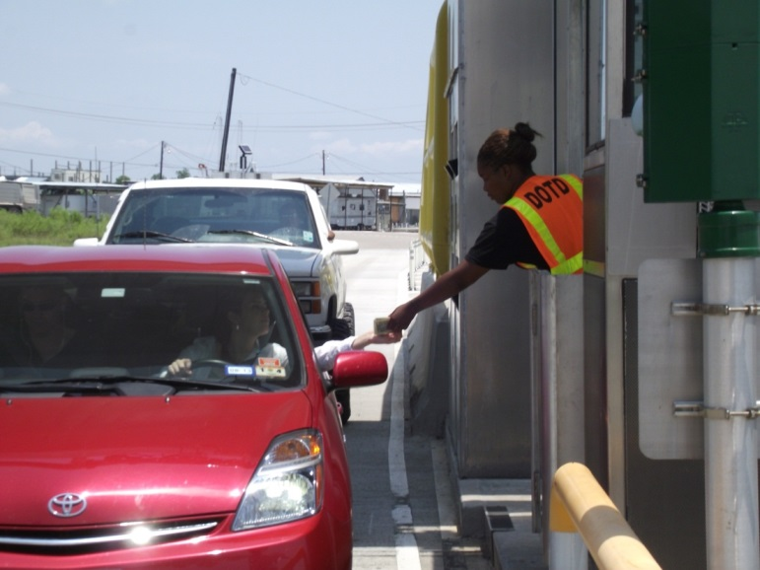
Previous Improvements
Cash Lane Lengthened before Summer Peak
Toll Booth Added, Toll Collection Staff Hired
Manual Toll Collection over Summer Peak
ATPM/Manual Collection Plan for Winter Months

Slide 3
Back Office Accomplishments
Violation Processing Improvements
Notices to be sent out within 30 days of violation
Backlog of images reviewed, notices to be mailed pending Act 206 process implemented
Out of State Violation Notices sent (YTD)
Texas - 670
Mississippi – 472
Act 206 Being Implemented
Became effective in June 2013
Reduces late notices from 3 to 1
Reduces late fees
Allows for communications by electronic mail

Slide 4
Customer Service Enhancements
Automated Notification Letters
Credit Card Expiration
Credit Card Auto Replenishment
Low Account Balance
Negative Balance
Guidelines for Resolution of Violations
Violation Hearings Held Locally or Over Phone

Slide 5
Revenue
Summer 2013 (Tolls Collected)
Monthly Breakdown
June $511,362.99
July $556,575.13 (Record High in Transactions)
August $575,622.73
Collection Rate of 95% in lane
Historical Collected vs. Expected Tolls
2011-2012 81% collected
2012-2013 96% collected

Slide 6
GeauxPass Efforts
1,826 Toll Tags Sold Since July 2013
Open Road Tolling (ORT) transactions - 66%
56% toll tag
10% V-toll using license plate image
Establishing a New User Agreement
Toll Tag Giveaways (La. 1 Coalition)
Acquired 1,000 additional tags:
375 handed out, 625 remaining
Requires minimum of $30 to qualify

Slide 7
Future Plans
Implement New AVI Multiprotocol Readers
6B, 6C, and IAG technology
Supports national interoperability
Exploring Single-Trip Payment Option
Alternate means of payment instead of cash, faster
More effective use of ATPM’s
New Legislation
Simplify toll schedule
Implement toll differential
RFP for Back Office Operations

Slide 8
Questions

